Slide 1

DES Pune University, Pune
School of Engineering and Technology
Department of Computer Science and Engineering
Title: A Persistent Browser-Based Virtual Pet System with Time-Aware State Management
by
Sr.No | PRN | Student Name
01 | 1012411001 | Riddhi Narendra Chatorikar
02 | 1012411009 | Mrudula Vijay Pimparwar
03 | 1012411012 | Lobhas Mahesh Kulkarni

Slide 2
INDEX
  INTRODUCTION
  PROBLEM STATEMENT
  OBJECTIVE
  PROJECT SCOPE
  BLOCK DIAGRAM AND WORKING
  RESULTS
  CONCLUSION
  REFERENCE

Slide 3
INTRODUCTION
A Persistent Browser-Based Virtual Pet System with Time-Aware State Management
  The project is an interactive browser-based virtual pet application developed using web technologies.
  Users can adopt and care for a virtual pet through activities such as feeding, playing, sleeping and bathing.
  The system tracks important pet attributes, including hunger, energy, happiness, cleanliness and health.
  LocalStorage preserves the pet's state between browser sessions.
  Time-aware state management allows the pet's condition to change based on the elapsed time between visits.
Technologies Used: HTML, CSS, JavaScript and LocalStorage.
1

Slide 4
PROBLEM STATEMENT
Traditional browser-based games may lose their progress when users leave or close the application. This reduces continuity and engagement.
Key Problems:
  Loss of pet status and game progress between visits.
  Lack of time-based changes in the pet's condition.
  Limited interaction between user actions and pet attributes.
  Need for an engaging and responsive user interface.
Proposed Solution: Develop a persistent virtual pet system that saves pet data, updates its condition over time and responds dynamically to user interactions.
2

Slide 5
OBJECTIVE
  To develop an interactive browser-based virtual pet application.
  To implement pet-care activities such as feeding, playing, sleeping and bathing.
  To maintain pet attributes and update them according to user actions.
  To store and restore pet data using LocalStorage.
  To implement time-aware state management based on elapsed time.
  To provide a responsive and user-friendly interface.
  To introduce progression through experience points (XP), coins, levels and achievements.
3

Slide 6
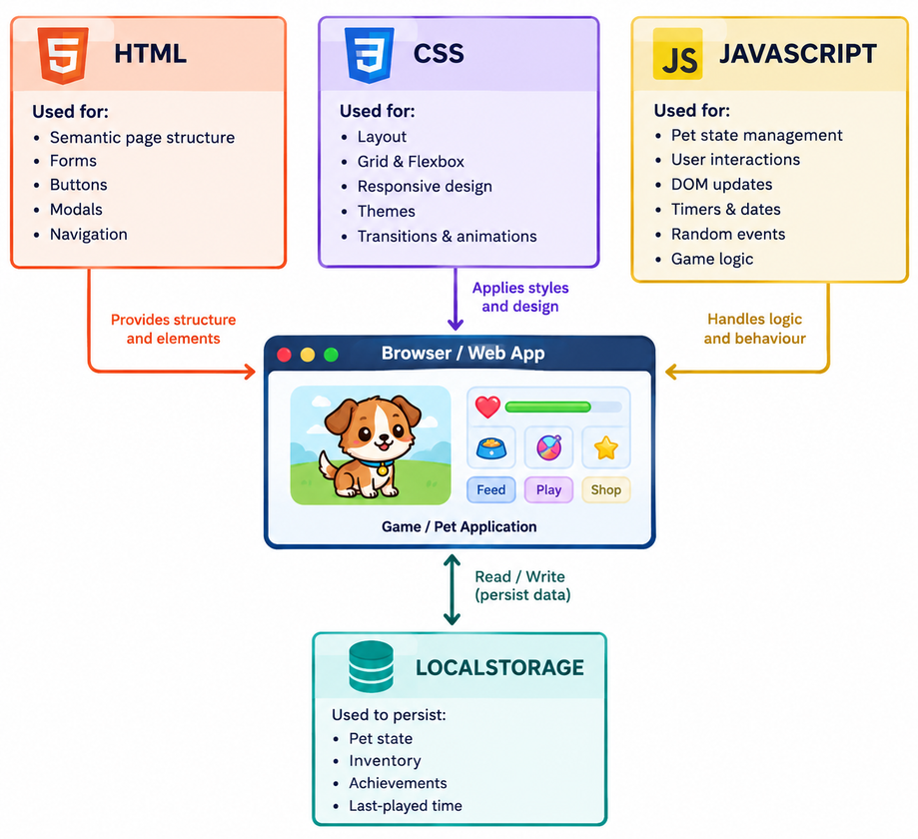
PROJECT SCOPE
Core Functionalities
  Virtual pet adoption and naming.
  Monitoring hunger, energy, happiness, cleanliness and health.
  Interactive pet-care actions.
  Time-based updates to pet condition.
  Persistent storage and restoration of game state.
  XP, coins, levels and achievement-based progression.
Technical Scope
  Client-side web application.
  HTML for structure.
  CSS for styling and responsive layouts.
  JavaScript for game logic and state management.
  Local Storage for persistent data storage.
Future Scope
  Multiple pet types and customization.
  Advanced mini-games and rewards.
  User accounts and cloud-based synchronization.
  Notifications and smarter pet behaviour.
4

Slide 7
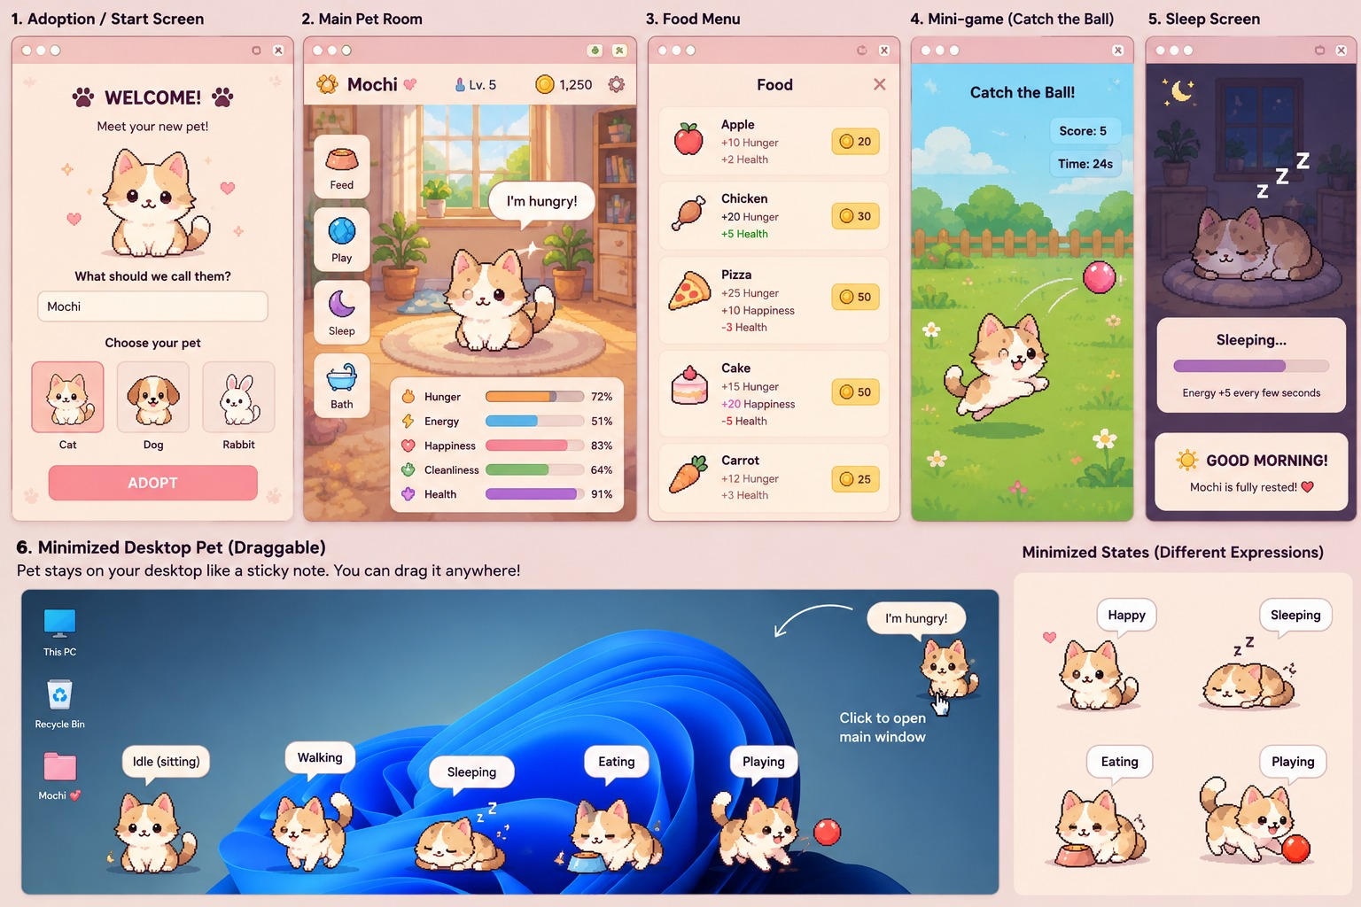
BLOCK DIAGRAM & WORKING
5

Slide 8
RESULTS
The project is designed to provide the following outcomes:
  An interactive virtual pet dashboard.
  Pet-care actions that modify pet attributes.
  Dynamic pet mood and condition display.
  Persistent storage of pet data using LocalStorage.
  Restoration of saved state between browser visits.
  Time-aware updates based on elapsed time.
  Progression features involving XP, coins and levels.
  A responsive interface for different screen sizes.
6

Slide 9
CONCLUSION
The project presents a browser-based virtual pet system that combines interactive gameplay with persistent data storage and time-aware state management. By integrating HTML, CSS, JavaScript and LocalStorage, the application aims to maintain continuity across user sessions while allowing pet attributes to respond to user actions and elapsed time. The project demonstrates the practical application of client-side web development, state management, event handling and browser storage in creating an engaging user experience.
7

Slide 10
REFERENCE
[1] MDN Web Docs, “HTML: HyperText Markup Language.”
https://developer.mozilla.org/en-US/docs/Web/HTML
[2] MDN Web Docs, “CSS: Cascading Style Sheets.”
https://developer.mozilla.org/en-US/docs/Web/CSS
[3] MDN Web Docs, “JavaScript.”
https://developer.mozilla.org/en-US/docs/Web/JavaScript
[4] MDN Web Docs, “Window: localStorage Property.”
https://developer.mozilla.org/en-US/docs/Web/API/Window/localStorage
[5] MDN Web Docs, “Date.”
https://developer.mozilla.org/en-US/docs/Web/JavaScript/Reference/Global_Objects/Date
8

Slide 11


